Slide 1







STACK OVERFLOW DEVELOPER SURVEY 2019
Sonali Margaret Rozario
2023-07-31

Slide 2



OUTLINE
Executive Summary
Introduction
Methodology
Results
Visualization – Charts
Dashboard
Discussion
Findings & Implications
Conclusion
Appendix

Slide 3

EXECUTIVE SUMMARY
Data contextualization and analysis goal.
Methodology description
Data Gathering
Data Analysis
Data Visualization
Results presentation supported with graphs and trends
Discussion of overall findings and implications regarding the results previously exposed.
Final conclusions of the carried out research.

Slide 4

INTRODUCTION
Stack Overflow’s annual Developer Survey is the largest and most comprehensive survey of people who code around the world.
Results don’t represent everyone in the developer community evenly.
Nearly 90,000 developers.
Trends to predict where the developers are going.
Characterization of developers around the globe.

Slide 5

METHODOLOGY
Collect survey data & explore its content
Web Scrapping
APIs
Request Libraries
Data Wrangling
Exploratory data analysis
Analyzing data distribution.
Handling outliers.
Exploratory Data Analysis
Analysis Data Distribution
Handling Outliners
Correlations
Data Visualization
Highlight distribution of data, relationships, the composition and comparison of data.
Dashboards

Slide 6
RESULTS

Slide 7
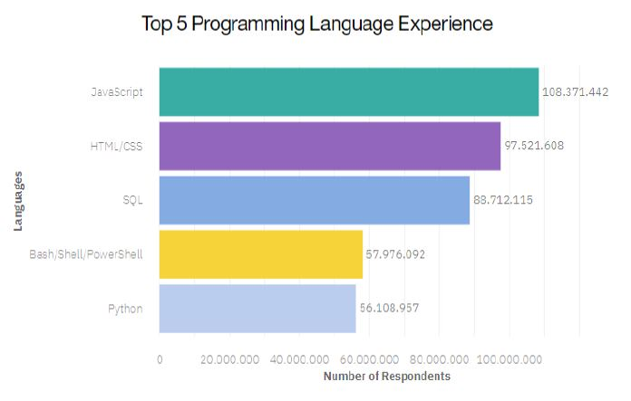
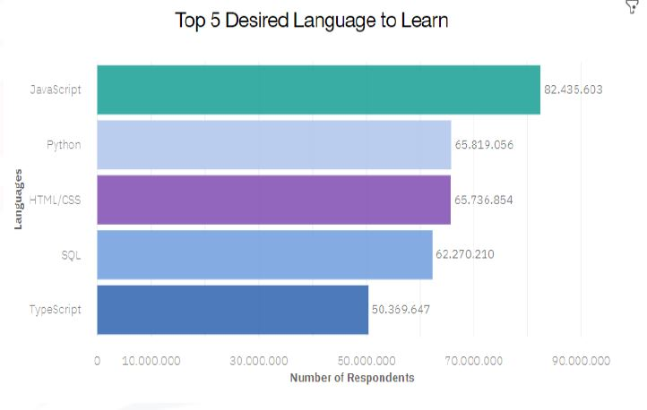
PROGRAMMING LANGUAGE TRENDS
Current Year
Next Year

Slide 8
PROGRAMMING LANGUAGE TRENDS - FINDINGS & IMPLICATIONS
Findings
JavaScript seems to keep as leading language.
Python fastest growing.
Great interest in TypeScript
Implications
Possible developers migration from JavaScript to TypeScript.

Slide 9
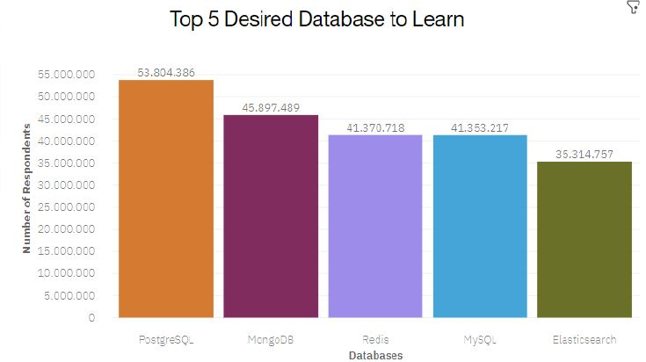
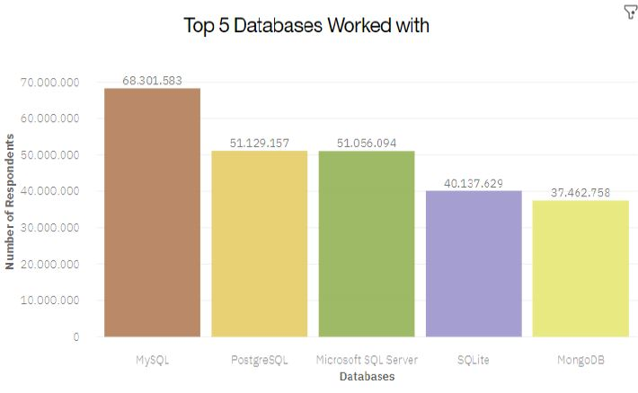
DATABASE TRENDS
Current Year
Next Year

Slide 10
DATABASE TRENDS - FINDINGS & IMPLICATIONS
Findings
MySQL as most used database.
Lack of interest in Microsoft SQL Server and SQLite.
Increasing interest in PostgreSQL and MongoDB.
Implications
Microsoft SQL Server and SQLite losing ground in the market.
PostgreSQL and MongoDB establishment in the market.

Slide 11

DASHBOARD
https://github.com/margaret-rozario/IBM-Capstone-Project

Slide 12
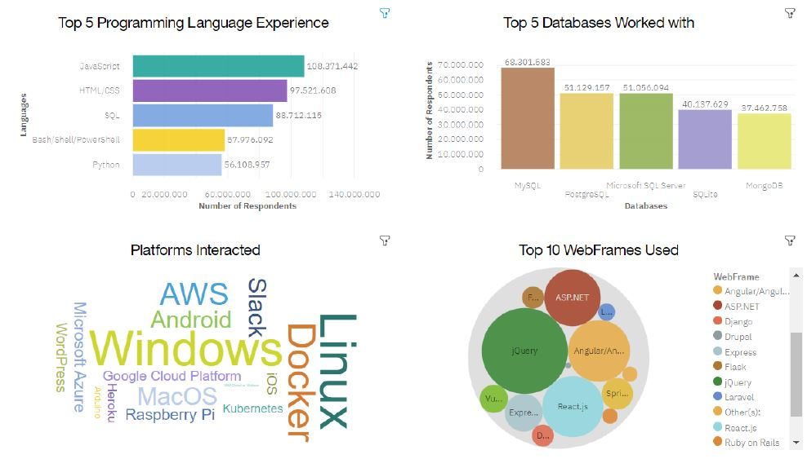
DASHBOARD TAB 1

Slide 13
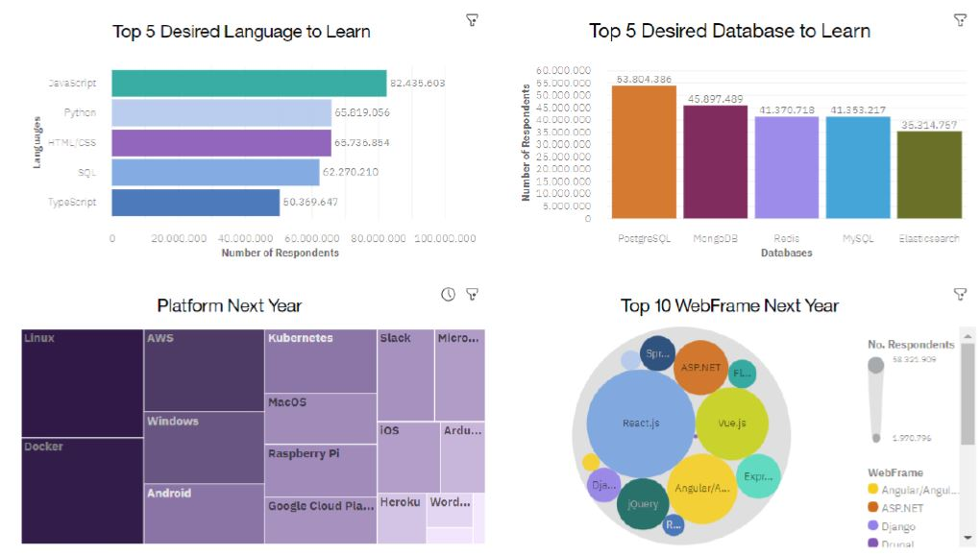
DASHBOARD TAB 2

Slide 14
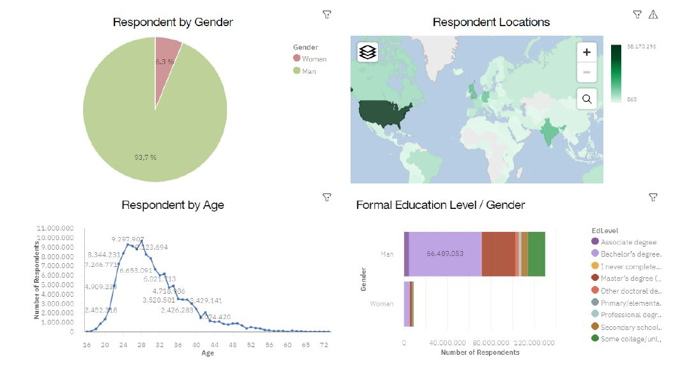
DASHBOARD TAB 3

Slide 15
DISCUSSION
Provided finding and implications

Slide 16
OVERALL FINDINGS & IMPLICATIONS
Findings
JavaScript widely used and TypeScript getting popular.
Over 90% young male developers.
Developers mostly located in developed countries.
Implications
JavaScript and TypeScript web frames gaining followers.
Global polarization of developers location and gender.
Young developers without postgrad studies on its majority.

Slide 17

CONCLUSION
Developers are people with very marked characteristics.
A good idea of popularity trends of different tools, platforms and languages can be obtained.
There is a job to be done to spread accessibility of this labor market to countries in development.

Slide 18

APPENDIX
All provided already.

Slide 19
JOB POSTINGS
In Module 1 you have collected the job posting data using Job API in a file named “job-postings.xlsx”. Present that data using a bar chart here. Order the bar chart in the descending order of the number of job postings.

Slide 20
POPULAR LANGUAGES
In Module 1 you have collected the job postings data using web scraping in a file named “popular-languages.csv”. Present that data using a bar chart here. Order the bar chart in the descending order of salary.

